Slide 1
Introduction to Kubernetes

Slide 2

What is Kubernetes?
A Production-Grade Container Orchestration System Google-grown, based on Borg and Omega, systems that run inside of Google right now and are proven to work at Google for over 10 years.
Extend the container goodness across nodes
Recovers automatically from failure
Basic monitoring, logging, health checking
Enables containers to find each other.
Reduce cost to run many things in production. Enables new ways of building applications.

Slide 3
What Kubernetes can do ?
Self Healing
Autoscale Workloads
Deployments - Roll Forwards / Rollbacks
Fire off jobs and scheduled cronjobs
Manage Stateless and Stateful Applications
Provide native methods of service discovery
Easily integrate and support 3rd party apps

Slide 4
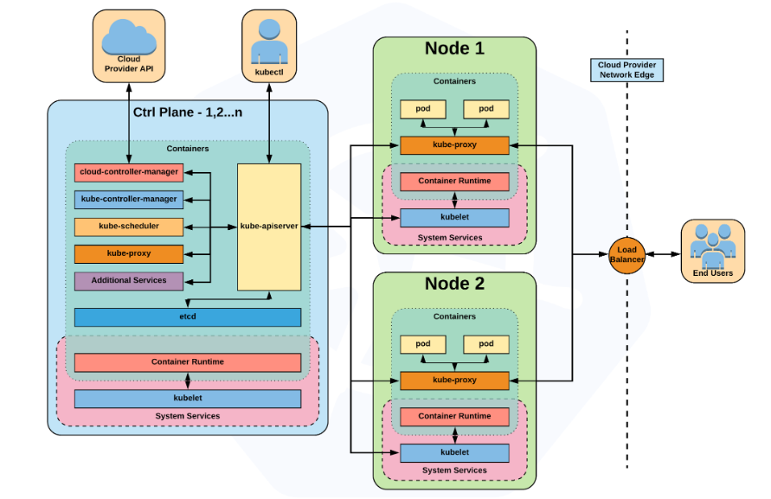

Kubernetes Architecture

Slide 5
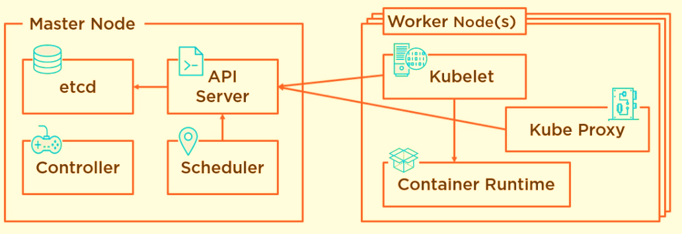
Kubernetes Architecture
Cluster store: Stores cluster state information
kubectl
Components | Ports (tcp) | Used By
API | 6443 | All
Etcd | 2379 – 2380 | API / etcd
Scheduler | 10251 | Self
Controller Manager | 10252 | Self
Kubelet | 10250 | Control plane
Service – (NodePort) | 30000 - 32767 | All

Slide 6
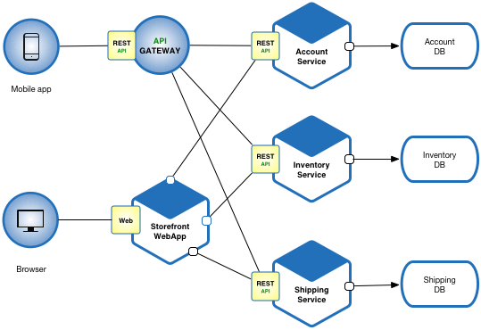

Micro service applications

Slide 7
Kubernetes Installation considerations
Where to Install?
Cloud
IaaS – Virtual Machines + manual installation
PaaS – Managed Kubernetes Service
On-Premises
Bare Metal
Virtual Machines
Which one to Choose?

Slide 8
Kubernetes Installation considerations cont…
What type of networking requirements for Cluster.
As per application architecture – Layer2 / Layer3
How many networks required in the cluster.
Scalability
Work load considerations
High availability of cluster in case of Disaster.
Data backup solution
Disaster Recovery
Data restoration – quick and easy

Slide 9
Kubernetes Installation methods
Windows and Mac platform
Docker Desktop
Minikube
On kubernetes native platform
Using kubeadm utility
Container engine supported
Container Runtime Interface (CRI)
Containerd
Docker (deprecated from 1.20 and removed from 1.23)
CRI-O
Cloud scenario
GKE
AKS
EKS
….
www.plusforum.in

Slide 10
Kubernetes Installation requirements
Packages required
containerd (container engine)
kubelet
kubeadm
kubectl
Steps to install and build the cluster
Install and configure above packages
Initiate and configure the cluster
Configure POD networking
Join worker / control-plane nodes to the cluster
www.plusforum.in

Slide 11

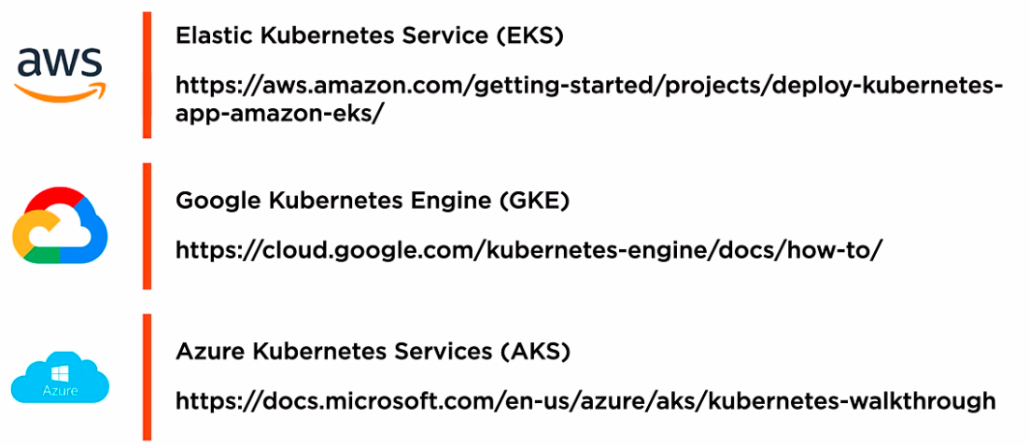
Kubernetes Cloud services

Slide 12
Azure Kubernetes Service (AKS)
Azure Kubernetes Service (AKS) simplifies deploying a managed Kubernetes cluster in Azure by offloading the operational overhead to Azure. As a hosted Kubernetes service, Azure handles critical tasks, like health monitoring and maintenance.

Slide 13
Comparison
Hypervisor / Virtualization
VMs
(Atomic Unit of Scheduling)
Docker
Containers
(Atomic Unit of Scheduling)
Kubernetes
PODs
(Atomic Unit of Scheduling)

Slide 14

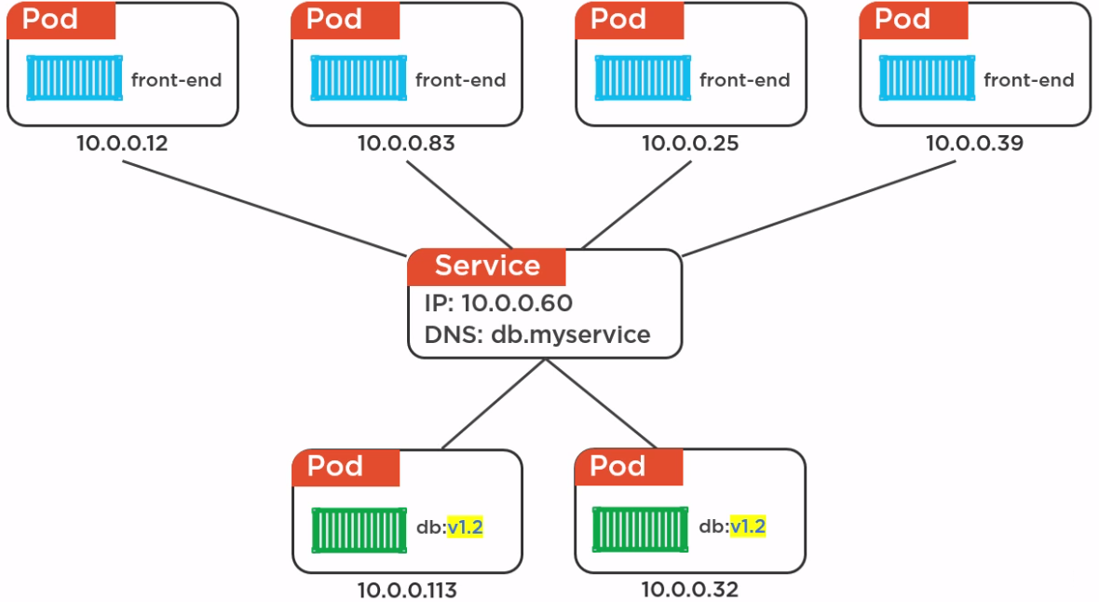
Load Balancer Services
10.1.23.10
DNS:myapp.service.com

